Slide 1

Smart Recycling
Team ERROR-404
Gamifying Carbon Footprint Reduction on Campus through AI and interactive tracking.

Slide 2

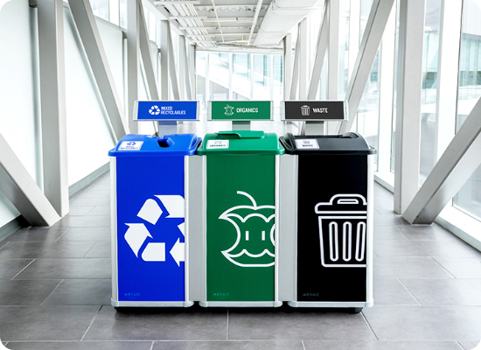
The Campus Challenge
Massive Daily Waste: Thousands of single-use plastics and cups are consumed daily on campus, ending up in regular bins.
No Engaging Tracking: Students have no motivating or transparent way to track their personal recycling impact.
Lack of Real-Time Metrics: The university operates without live data on recycling rates or carbon footprint reduction.
Resource Waste: This leads to severe environmental pollution and missed sustainability targets.

Slide 3









Our Solution
Scan & Verify
Earn Rewards
Redeem
Students access their personal QR code. An AI-powered camera instantly verifies the material (plastic, glass, paper).
Instantly earn Green Points and track exact grams of CO₂, Crude Oil, and Electricity saved per recycled item.
Accumulated points can be redeemed in the built-in rewards store for free coffee, notebooks, or meal discounts.

Slide 4

System Intelligence
Fraud Prevention Built-In
Our Admin Dashboard actively monitors and logs Fraud Attempts Blocked to ensure system integrity. The AI strictly differentiates between actual recyclables and non-recyclable garbage.
98.5%
We also feature Future Projections, calculating a student's 1-month and 1-year impact based on their current recycling habits to drive long-term behavioral change.
AI Accuracy Rate

Slide 5


Inside the Platform
Recycle Page (AI Object Verification) Upload a photo for the system to verify the material automatically. Includes a unique, scannable QR Code generator for secure student identification.
Student Profile (Impact & Rewards) Monitor exact CO₂, Crude Oil, and Electricity saved towards personalized goals (e.g., 10kg CO₂). Unlock tiers for free items as points accumulate.
Admin Dashboard (Live Analytics) Real-time feed of recent scans, total green points, top carbon savers leaderboard, and interactive donut charts showing waste distribution.

Slide 6

Tech Stack
Built in 48 Hours
We engineered Smart Recycling with a robust, data-driven architecture to ensure seamless live performance and scalability.
Backend: Python for high-speed data processing.
Frontend: Streamlit for interactive, dark-mode dashboards.
AI Engine: Object Verification & Fraud Detection simulation.
Data Base: Live Pandas DataFrames & Interactive Charts.

Slide 7
The Student Journey
Recycle & Scan
Redeem
AI verifies the uploaded object (e.g., plastic bottle) at the bin.
Student uses accumulated points for free campus coffee or merch.
Register
Track Impact
Student logs in and accesses their unique identifier QR Code.
Points and CO₂ savings instantly appear in the Student Profile.

Slide 8
Thank You!
Smart Recycling: The step toward a sustainable campus.
Team ERROR-404
Abdullah Al Smadi | Vael Kuloglu

